Slide 1
Gaussian Process
Chu Duc Thang
Nguyen Ngoc Tuan

Slide 2
Outline
1. Prerequisite
2. Background
3. Requirements, assumptions and settings
4. Gaussian Process
5. Intuition, advantages and disadvantages
6. Kernel
7. Summary
8. Citation and Demo

Slide 3





1. multivariate GAUSSIAN (Pre-requisite)
Setting
Marginalization
Conditional
Note: Once Gaussian, always Gaussian
Importance: Central Limit Theorem

Slide 4
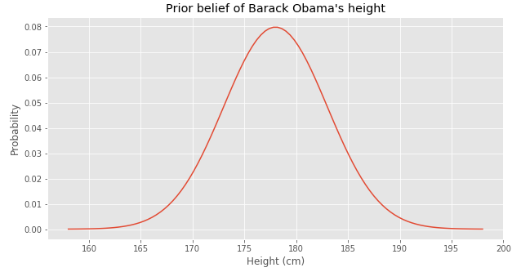

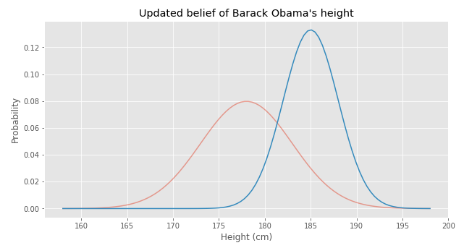
WHAT IS OBAMA’S HEIGHT

Slide 5
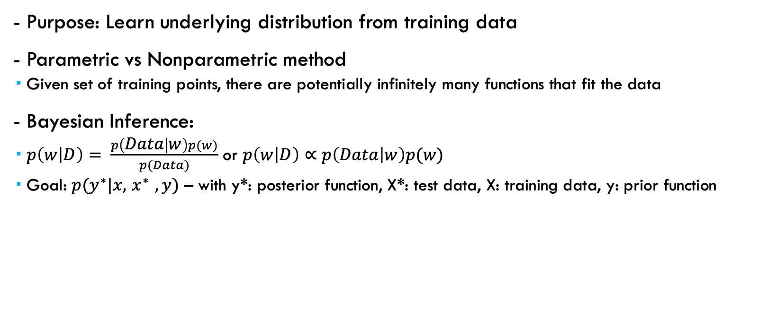
2. Background
- Purpose: Learn underlying distribution from training data
- Parametric vs Nonparametric method
Given set of training points, there are potentially infinitely many functions that fit the data
- Bayesian Inference:
$p\left(w | D\right)= \frac{p\left(Data | w\right)p(w)}{p(Data)}$ or $p\left(w | D\right)∝$ $p\left(Data | w\right)p(w)$
Goal: $p(y^{∗}|x, { x}^{∗} , y)$ – with y*: posterior function, X*: test data, X: training data, y: prior function

Slide 6
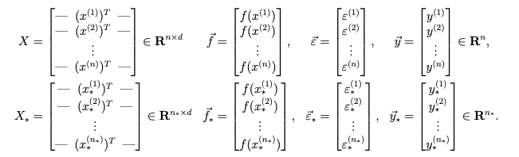


3. Requirements, assumptions and settings
- Regression problem:
Extension version can be used for classification problem
$y =f\left(x\right)+ε$

Slide 7

4. Gaussian Process
Definition: A GP is a (potentially infinite) collection of random variables such that the joint distribution of every finite subset of random variables is multivariate Gaussian
Prior: Assuming the mean of function is 0 $p\left(y | x\right) \sim 𝒩(μ=0, K)$
Posterior: After observing $y^{∗} and x^{∗}$, we use the Bayesian rules as followed

Slide 8




4. Gaussian Process
Gaussian process: modelling probability distributions over functions $p(y^{∗}|y, x^{∗},x)$

Slide 9
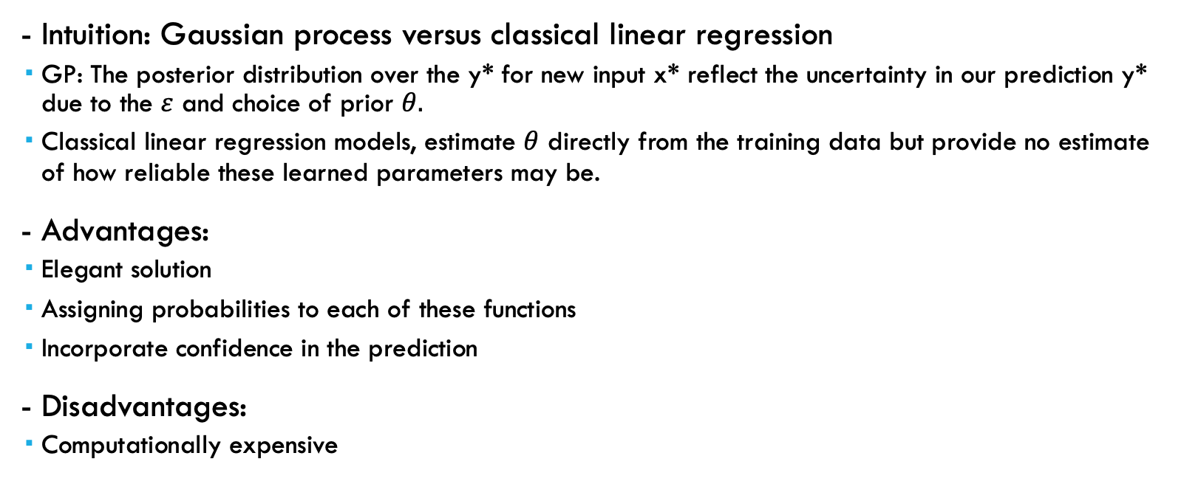
5. Intuition, advantages and disadvantages
- Intuition: Gaussian process versus classical linear regression
GP: The posterior distribution over the y* for new input x* reflect the uncertainty in our prediction y* due to the $ε$ and choice of prior $θ.$
Classical linear regression models, estimate $θ$ directly from the training data but provide no estimate of how reliable these learned parameters may be.
- Advantages:
Elegant solution
Assigning probabilities to each of these functions
Incorporate confidence in the prediction
- Disadvantages:
Computationally expensive

Slide 10


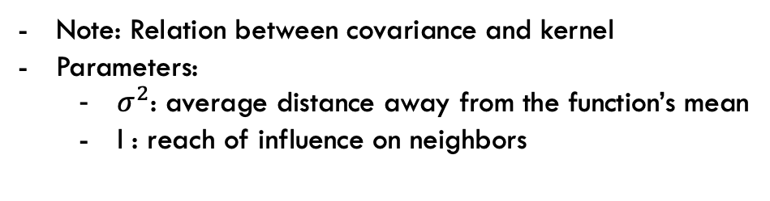
6. Kernel
- Definition: Outputs the similarity between 2 given points
- Example: Squared Exponential Kernel
Note: Relation between covariance and kernel
Parameters:
$σ^{2}$: average distance away from the function’s mean
l : reach of influence on neighbors

Slide 11
7. Summary
GP: estimation of function, instead of parameters
Bayesian inference
Non-parametric method

Slide 12
8. Citation
https://distill.pub/2019/visual-exploration-gaussian-processes/
http://cs229.stanford.edu/summer2020/gaussian_processes.pdf
https://www.cs.cornell.edu/courses/cs4780/2018fa/lectures/lecturenote15.html

